Slide 1
ATOMIC ENERGY EDUCATION SOCIETY
SUBJECT – GEOGRAPHY
STREAM – ARTS
CLASS -11th
CHAPTER-01
Geography as a Discipline
MODULE-02/02
Prepared By: Mr S.SADHUKHAN (PGT-SS)
AECS-2, JADUGUDA

Slide 2
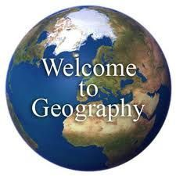

Slide 3

SYSTEMATIC GEOGRAPHY
PHYSICAL GEOGRAPHY
HUMAN GEOGRAPHY
BIOGEOGRAPHY

Slide 4
PHYSICAL GEOGRAPHY
GEOMORPHOLOGY
CLIMATOLOGY
HYDROLOGY
SOIL GEOGRAPHY

Slide 5
    Geomorphology is devoted to the study of landforms, their evolution and related processes.
    Climatology encompasses the study of structure of atmosphere and elements of weather and climates and climatic types and regions.
    Hydrology studies the realm of water over the surface of the earth including oceans, lakes, rivers and other water bodies and its effect on different life forms including human life and their activities.
    Soil Geography is devoted to study the processes of soil formation, soil types, their fertility status, distribution and use.

Slide 6
HUMAN GEOGRAPHY
SOCIAL/ CULTURAL GEOGRAPHY
POPULATION AND SETTLEMENT GEOGRAPHY
ECONOMIC GEOGRAPHY
HISTORICAL GEOGRAPHY
POLITICAL GEOGRAPHY

Slide 7
Social/Cultural Geography encompasses the study of society and its spatial dynamics as well as the cultural elements contributed by the society.
(ii) Population and Settlement Geography (Rural and Urban). It studies population growth, distribution, density, sex ratio, migration and occupational structure etc. Settlement geography studies the characteristics of rural and urban
settlements.
(iii) Economic Geography studies economic activities of the people including agriculture, industry, tourism, trade, and transport, infrastructure and services, etc.

Slide 8
  (iv) Historical Geography studies the historical processes through which the space gets organised. Every region has undergone some historical experiences before attaining the present day status. The geographical features also experience temporal changes and these form the concerns of historical geography.
  (V) Political Geography looks at the space from the angle of political events and studies boundaries, space relations between neighbouring political units, delimitation of constituencies, election scenario and develops theoretical
  framework to understand the political behaviour of the population.

Slide 9
BIOGEOGRAPHY
PLANT GEOGRAPHY
ZOO GEOGRAPHY
ENVIRONMENTAL GEOGRAPHY
ECOLOGY

Slide 10
(i) Plant Geography which studies the spatial pattern of natural vegetation in their habitats.
(ii) Zoo Geography which studies the spatial patterns and geographic characteristics of animals and their habitats.
(iii) Ecology /Ecosystem deals with the scientific study of the habitats characteristic of species.
(iv) Environmental Geography concerns world over leading to the realisation of environmental problems such as land gradation, pollution and concerns for conservation has resulted in the introduction

Slide 11
REGIONAL APPROACH
REGIONAL STUDIES - macro, meso and micro
REGIONAL PLANNING – rural and urban
REGIONAL DEVELOPMENT
REGIONAL ANALYSIS
Philosophy
Methods and techniques
statistical techniques
Field survey
Remote sensing, GIS, GPS

Slide 12
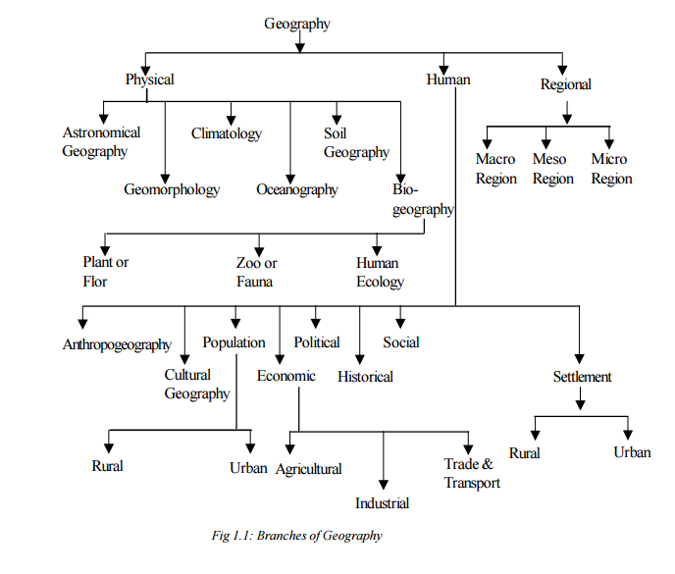

Slide 13
PHYSICAL GEOGRAPHY
Lithosphere
(landforms, drainage, physiography......)
Atmosphere
(composition, structure, climate, wind, precipitation .......)
Hydrosphere
  (oceans, lakes, rivers ......)
Biosphere
(life forms, food chain, ecological balance ...)

Slide 14
Pedogenesis
Soils are formed through the process of pedogenesis and depend upon the parent rocks, climate, biological activity and time.

Slide 15
The study of physical geography is emerging as a discipline of evaluating and managing natural resources. In order to achieve this objective, it is essential to understand the intricate relationship between physical environment and human beings.

Slide 16
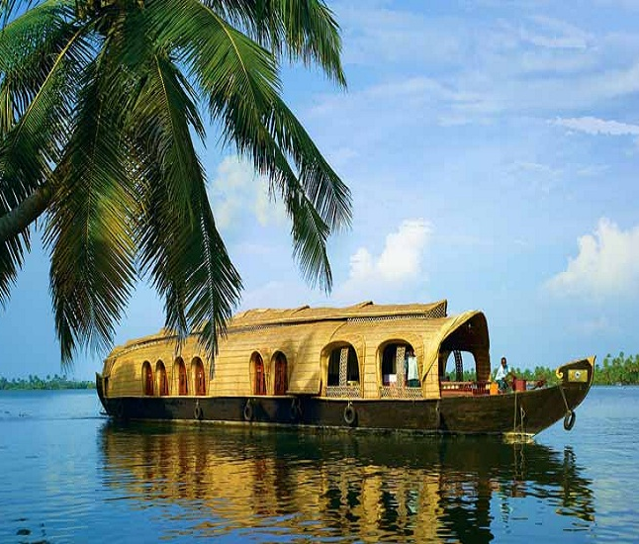
Thank
You

